Slide 1
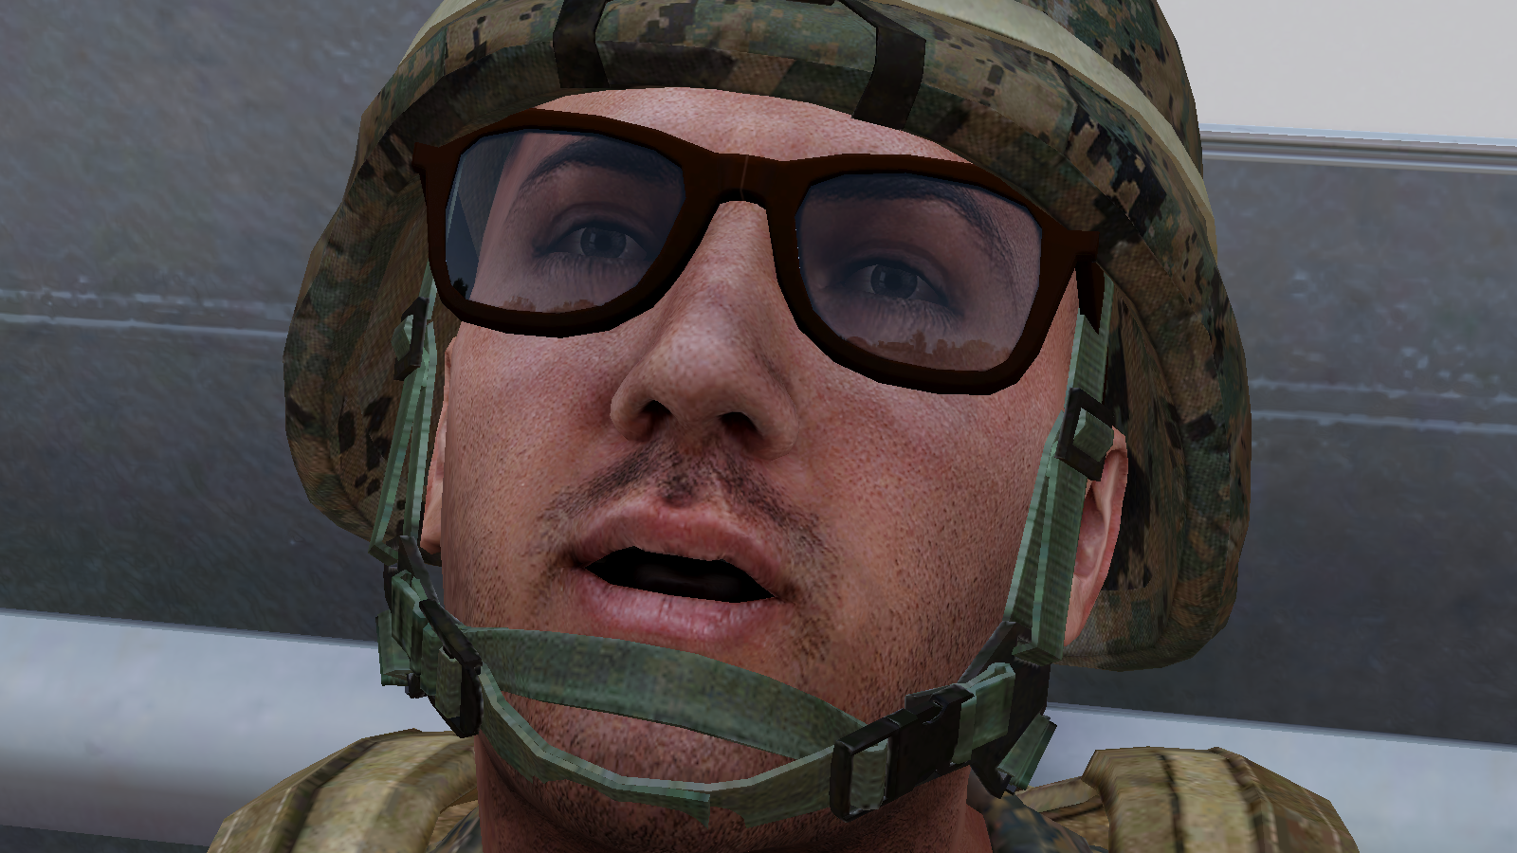

How to Prevent Holes, Fix Holes and Make Holes

Slide 2
How we Play
This depends largely on the Mission Creator/Zeus.
Level of Seriousness - Cancer, Casual, Serious.
Mission Types - One life, limited respawns, unlimited respawns.
Arsenals/Loadouts - Full, Limited, None. Usually tied to faction.
Roles - Usually we will use proper squad hierarchy & roles.
Enemy Gear - Don't loot unless necessary, especially uniforms.
Immersion - Don't use chat if you are dead/spectating.
Cancer – There’s a balance to be struck.

Slide 3
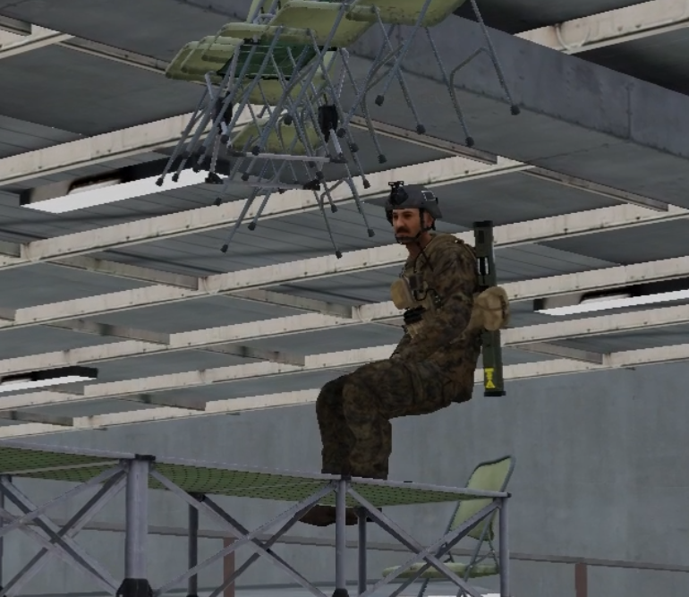
What is Cancer?
“A term used for something that is so fucked up, that it is figurably able of giving you cancer.”
“Johnny is so cancer that almost everyone hates him.” - Urban Dictionary
Cancer in moderation is ok.

Slide 4
Controls
These are some basic keybinds & settings to get by, but there are many more.
ACE Interaction & Self Interaction.
How to edit CBA Controls.
TSP Controls
↳ Animate
↳ Melee
↳ Ragdoll
↳ Earplugs.
View distance settings.
Leaving spectate.

Slide 5
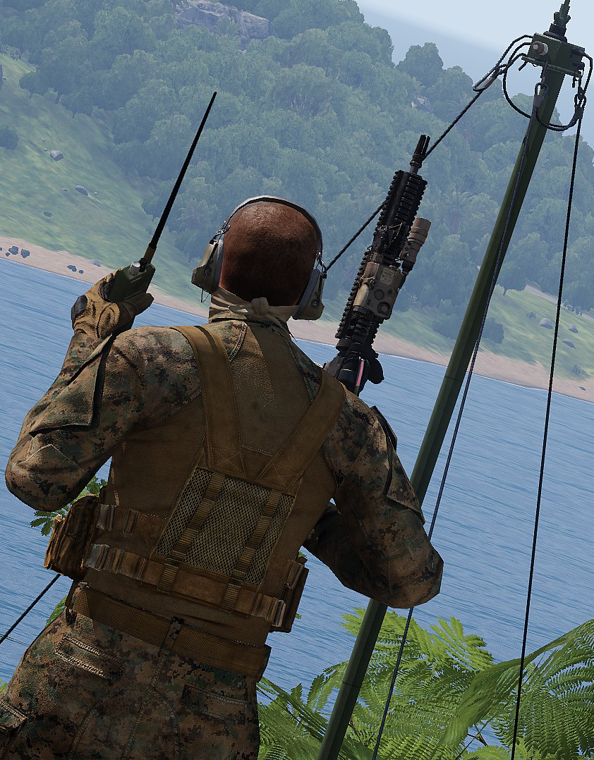
Communication
How to use ACRE2
↳ Changing Volume.
↳ Changing Channels.
↳ Multiple Radios.
Protocol
↳ Who is talking or who should listen?
↳ Only transmit relevant information.
↳ Keep messages short and simple.

Slide 6
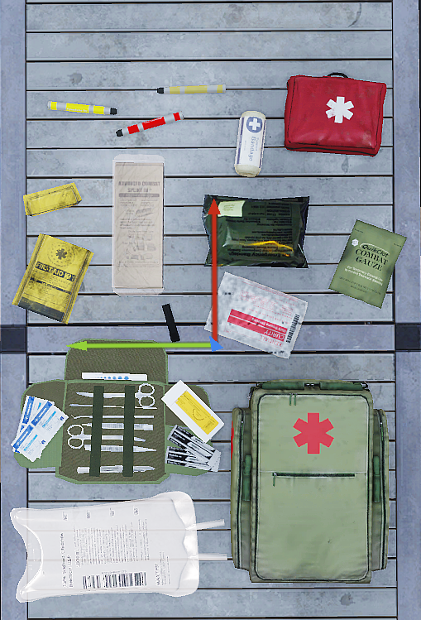
Medical
ACE Medical
↳ Bleeding - Tourniquets, Bandages.
↳ Heart rate - Epinepherine, Morphine, Adenosine, CPR.
↳ Breaks - Splints.
↳ Pain - Painkillers, Morphine.
↳ Consciousness - Heart rate, blood pressure, pain.
↳ Medics - Surgery, transfusions.
Medical Packages
↳ First Aid Kit - Contains few items.
↳ Individual First Aid Kit - Contains essentials.
↳ Medikit - Contains medic items (Surgical Kit, Saline).

Slide 7
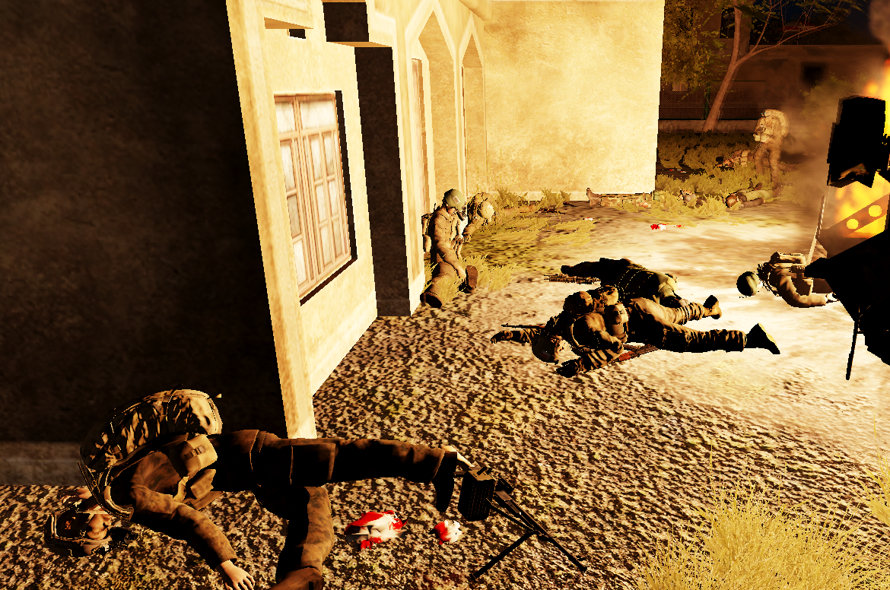
Explosives
ACE Throwing.
ACE Explosives & Detonators.
Warn others before using an explosive/launcher/grenade.
When possible, attempt to warn those around you of backblast when firing a launcher.
When dealing with explosives, the placer is responsible for making sure it is safe before touching off.

Slide 8
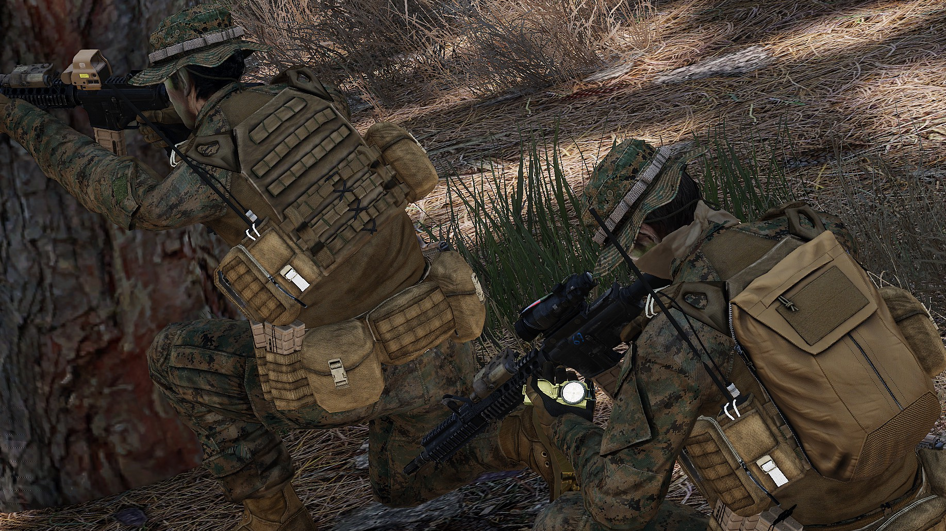
Leading
Radio Setup.
Blue Force Tracking.
Basic Map Terminology ↳ BOF – Base of Fire ↳ OP – Overwatch Position ↳ BP – Breach Point ↳ LZ – Landing Zone ↳ DP – Dismount Point ↳ MSR – Main Service Road ↳ OBJ – ObjectiveUse fireteam colours to subdivide squad.
Keep your team together and informed.
Responsible for the mounting/dismounting of vehicles.
Keep plans simple & flexible.

Slide 9
Questions and Answers

